Slide 1

Identify Age Related Condition
Project Submitted by:
VANSHIKA (SID: 041044413)
SARTAJ SINGH BABRA (SID: 041094831)
NAITIK TALATI (SID: 041084256)
SAIYAM SHAH: (SID: 041080364)
JAY PATEL (SID: 041085500)

Slide 2
Background and Objective
They say age is just a number but a whole host of health issues come with aging. From heart disease and dementia to hearing loss and arthritis, aging is a risk factor for numerous diseases and complications.
Data science could have a role to play in developing new methods to solve problems with diverse data, even if the number of samples is small.
The goal of this competition is to predict if a person has any of three medical conditions. We have to predict if the person has one or more of any of the three medical conditions (Class 1), or none of the three medical conditions (Class 0). For this a model trained on measurements of health characteristics.

Slide 3
Understanding the data
Train.csv - The training set.
ID: Unique identifier for each observation.
AB-GL Fifty-six anonymized health characteristics. All are numeric except for EJ which is categorical.
Class A binary target: 1 indicates the subject has been diagnosed with one of the three conditions, 0 indicates they have not.
Test.csv - The test set. Your goal is to predict the probability that a subject in this set belongs to each of the two classes
Geek, csv - Supplemental metadata, only available for the training set

Slide 4
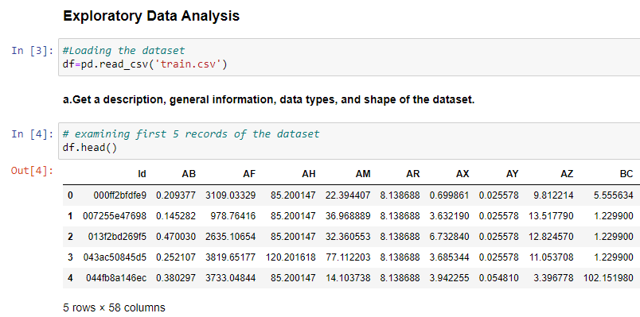
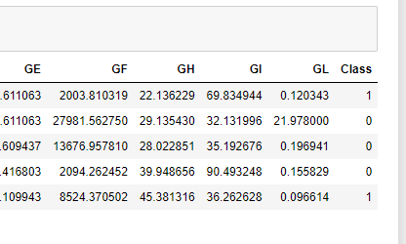
Data Exploration
For any kind of prediction, it is important for any analysist to explore the data and understand the trends which further helps to improve the efficiency of the prediction by getting rid of outliers of missing values.
Target variable with binary value “1” and “0”
The dataset includes 58 features out of which 56 are the health condition and 1 is class and last is ID

Slide 5
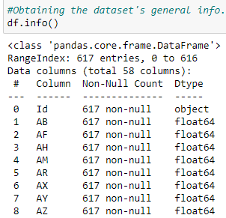
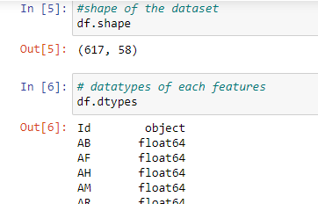
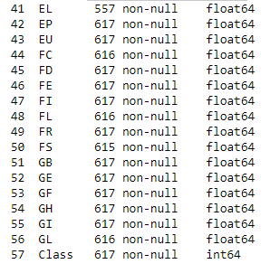
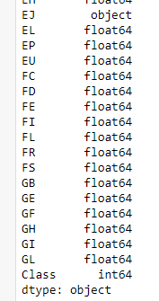

Data Exploration
Data consist of 617 records and their data distributed amongst 58 features
v
v
v
EJ which is a categorical column is defined as object, will be taking care of this later during feature engineering
Finding null value: yes, there are null values in many column as highlighted again, we will be updating this in feature engineering section

Slide 6
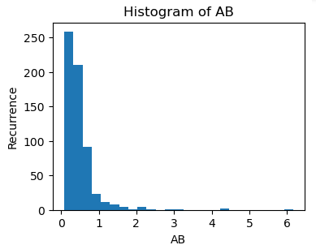
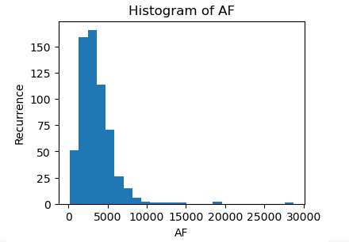
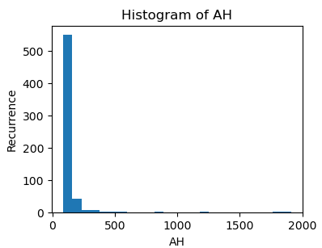
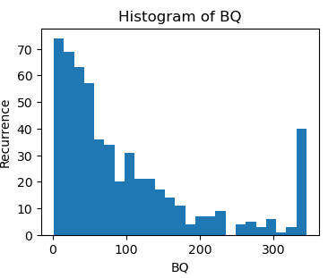
Data Exploration
Plotting histogram for each health condition to understand the distribution
There are total 56 features which depicts anonymized health characteristics, it would be difficult to summarise the distribution for all 56. So, we have picked up random 4 for the explanation
As per our observation, most of the health characters were right skewed and could be possible as most of the health condition scales from 0 to some value
AB: most of the data falls b/w 0.1 to 0.6
AF: 1000 to 5000
AH:0 to 100 and BQ: 0 to 100 and some are above 300
AB
AF
AH
BQ

Slide 7
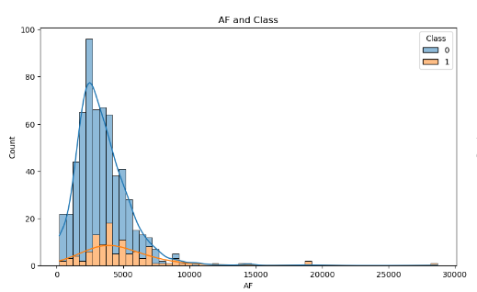
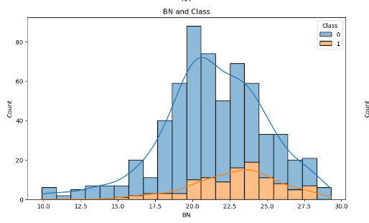
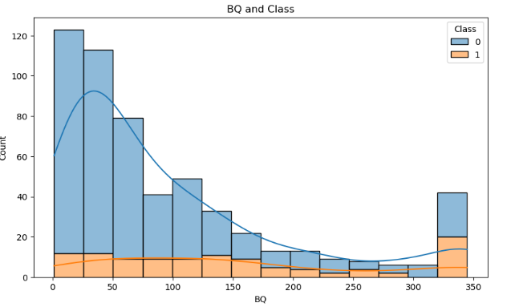
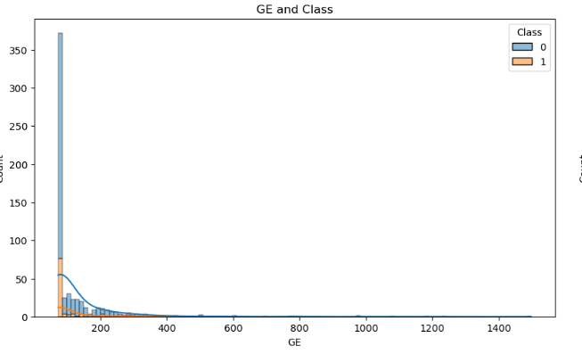
Data Exploration
We have now checked the distribution of Class “target variable” with the health condition
The orange represents 1 and blue represents 0
Those who are facing the condition have different level are distributed to each level , chances of getting outliers is low
AF
BN
GE
BQ

Slide 8
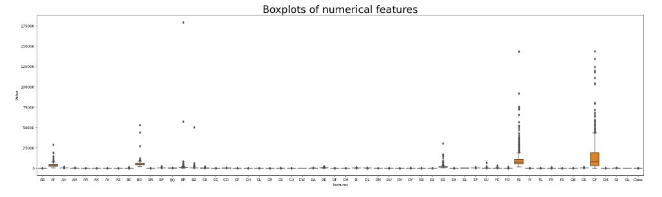
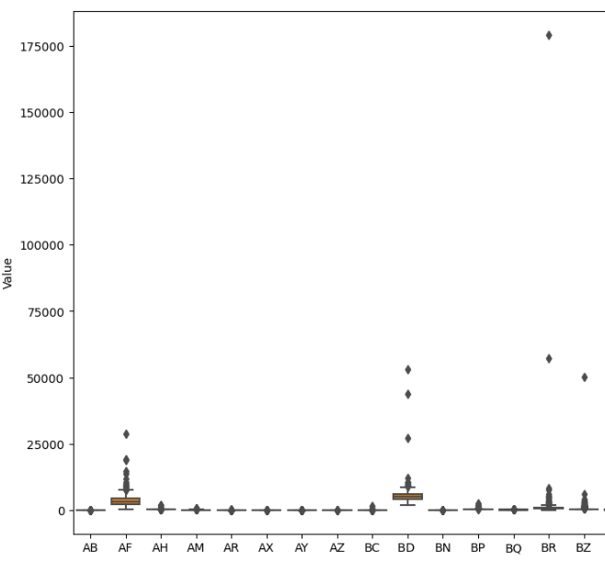
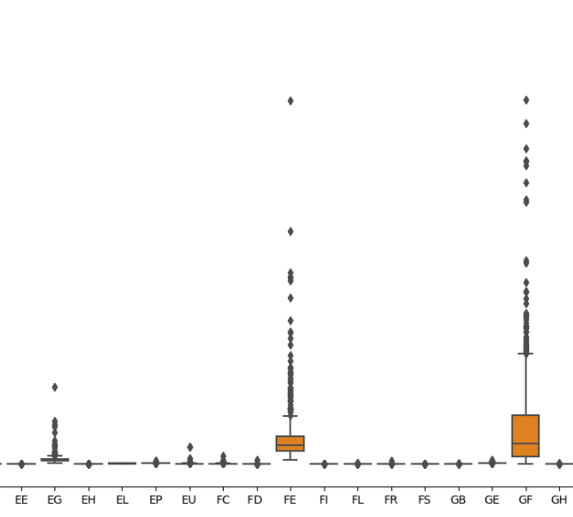
Data Exploration
Using Boxplot: we have checked the distribution of outliers:
The box plot gave us a clear picture of the outliers for each health condition, we will definitely take care of these later
AF, BD, BR, BZ, EF, FE and GF are some examples

Slide 9
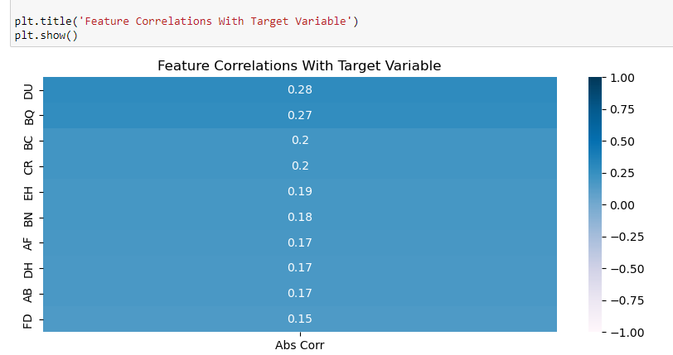
Correlation with target variable
This graph display the relationship of target variable with different health condition displaying only numbers greater than 0.15C

Slide 10
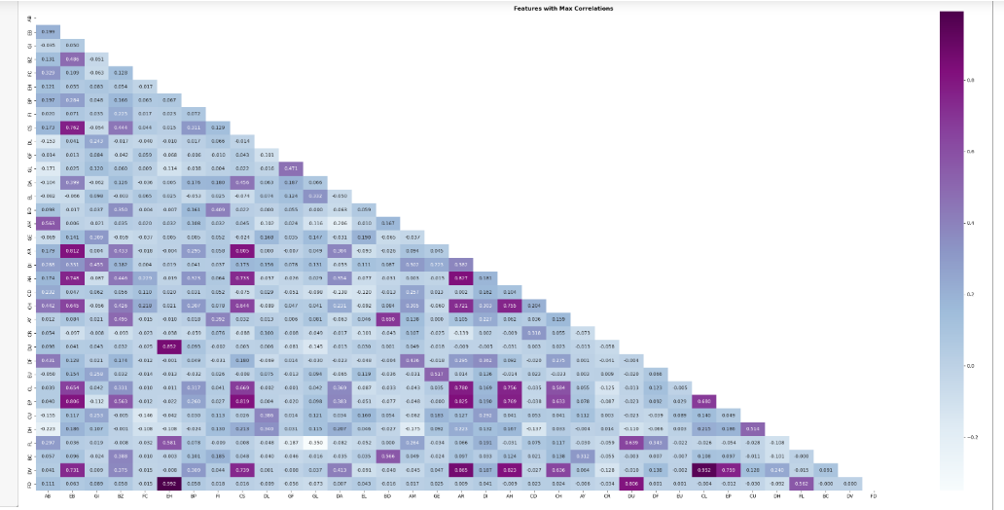
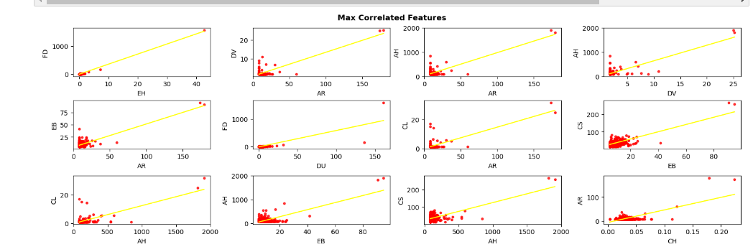
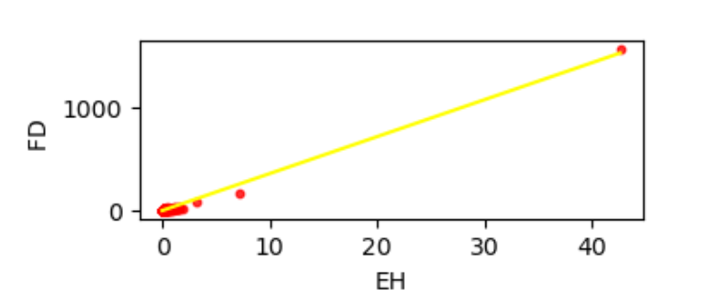
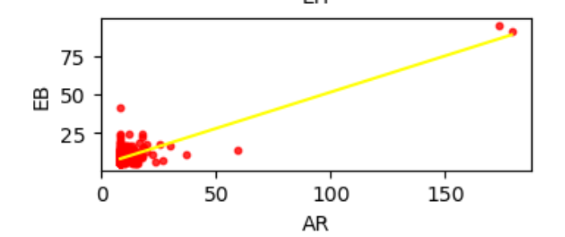
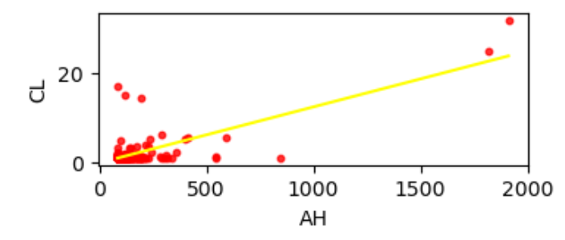
Features with Max Correlation
Heatmap displays the relation b/w the health conditions purple being highly correlated and below being the least
Scatter plot was plotted to understand the distribution between each condition

Slide 11
Feature Engineering:

Slide 12

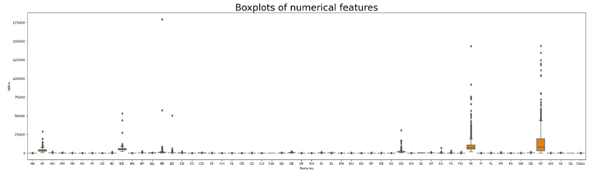
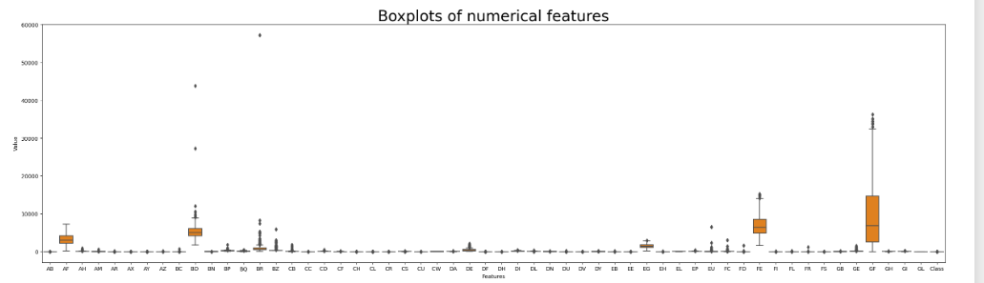
First removing outliers using IQR
Using IQR method, the outliers were removed from the top 4 columns
AF, EG, FE and GF

Slide 13
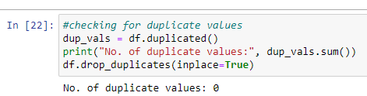
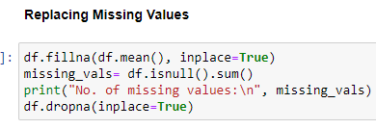
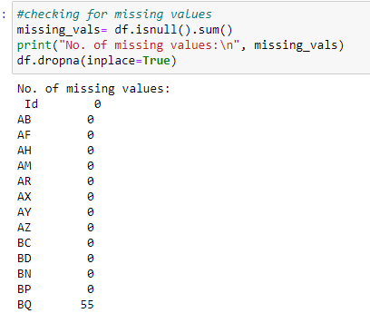





Checking Duplicates and Replacing null values
No Duplicates found
Found some missing value and these were replaced by mean

Slide 14
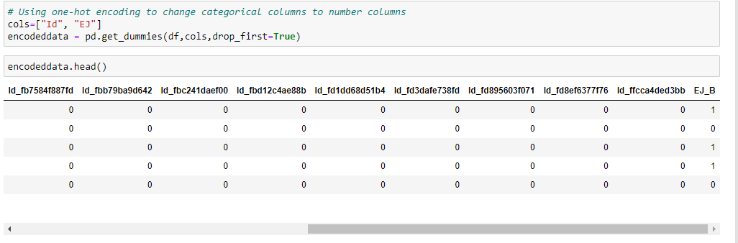
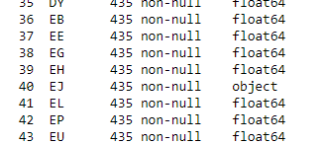
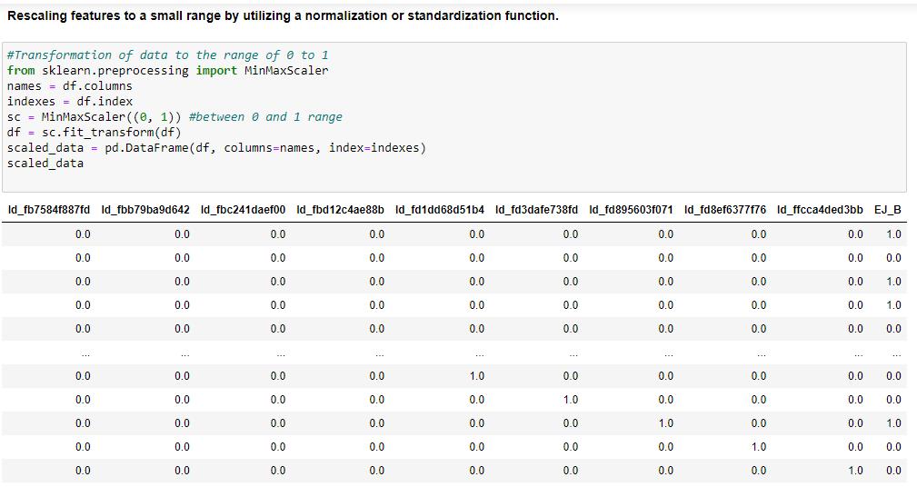
Converting Categorical data to Numeric
Rescaling features to a small range by utilizing a normalization or standardization function.

Slide 15
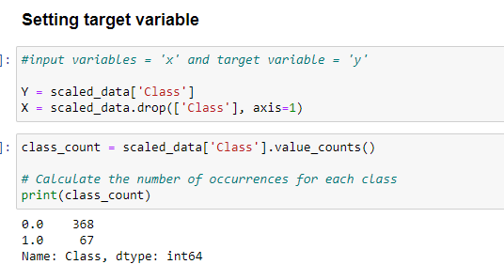
Setting Target variable and Splitting the data

Slide 16
Modelling

Slide 17
Modelling and Pipeline
To predict the target variable, below regression models were created, hyperparameter and ensembling techniques were followed to improve the performance
Logistic Regression
Hyperparameter tuning Logistic Regression
Gradient Boosting (Ensembling- boosting)
Hyperparameter tuning Gradient Boosting (Ensembling with HP tuning))
Support Vector Machine
Hyperparameter tuning Support Vector Machine
KNN Classifier
Hyperparameter tuning KNN Model
Random Forest

Slide 18
Evaluation Metrics
Accuracy: It measures the overall correctness of predictions made by a model. It's calculated as the number of correct predictions divided by the total number of predictions.
Recall (also known as Sensitivity): It measures the ability of a model to identify all positive instances correctly. It's calculated as the number of true positive predictions divided by the sum of true positives and false negatives.
Precision: It measures the accuracy of positive predictions made by a model. It's calculated as the number of true positive predictions divided by the sum of true positives and false positives.
F1 Score: It is the harmonic mean of precision and recall. It's used to find a balance between precision and recall. It's calculated as 2 * (Precision * Recall) / (Precision + Recall).

Slide 19
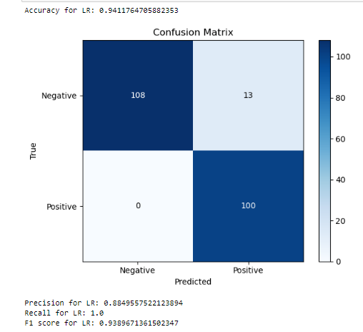
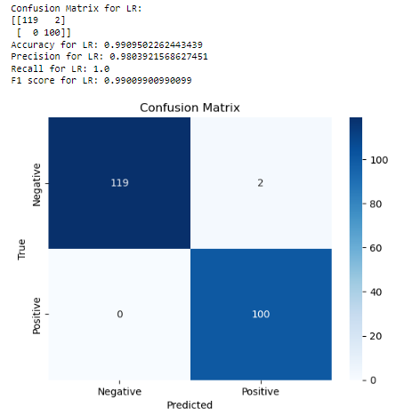
Logistic Regression and LR with HPT
Logistic Regression
Logistic Regression using HPT
V/S
In summary, the "LR HPT" model outperforms the regular Logistic Regression model in all evaluated metrics. It achieves higher accuracy, fewer misclassifications, and better precision-recall trade-off.

Slide 20
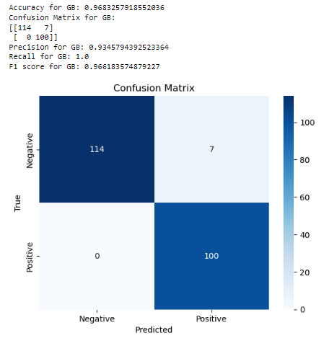
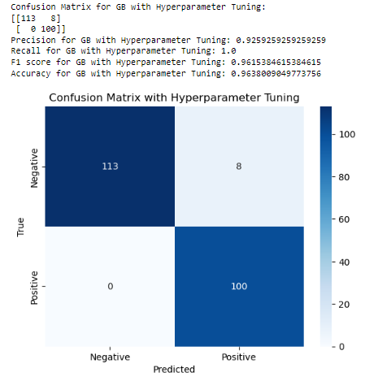
Gradient Boosting and GB using HPT
Gradient Boosting
GB using HPT
V/S
The "GB" model outperforms the "HYPERPARAMETER TUNING Gradient Boosting" model in terms of accuracy, the confusion matrix, precision, recall, and F1 score.

Slide 21
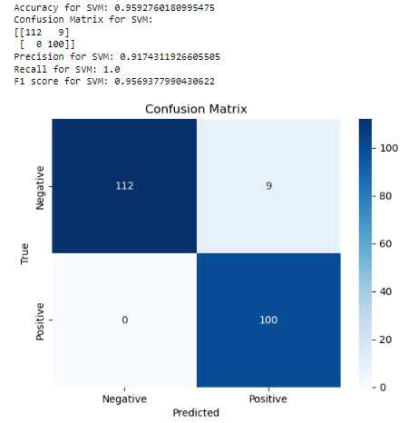
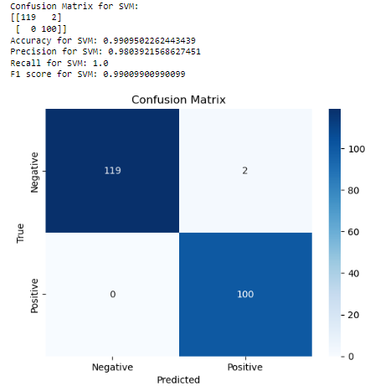
SVM and SVM using HPT
SVM
SVM using HPT
V/S
Based on the evaluation metrics, the "HYPERPARAMETER TUNING Support Vector Machine" model outperforms the regular "SVM" model in terms of accuracy, the confusion matrix, precision, recall, and F1 score.

Slide 22
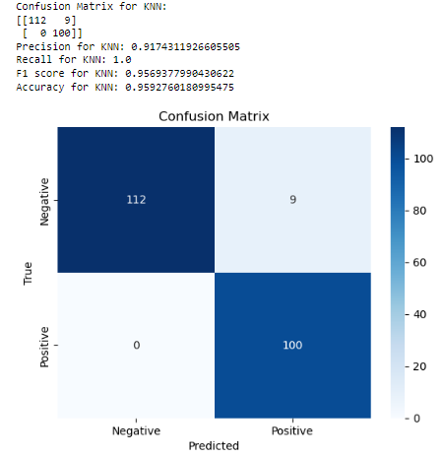
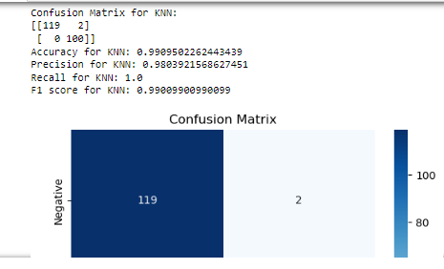
KNN and KNN using HPT
KNN
KNN using HPT
V/S
Therefore, the "HYPERPARAMETER TUNING KNN" model is better in this case and should be preferred over the regular "KNN Classifier" model for this particular problem.

Slide 23
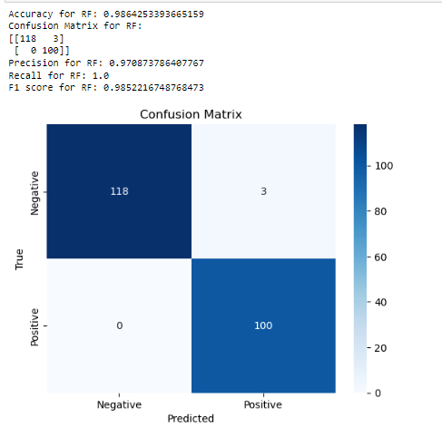
Random Forest

Slide 24
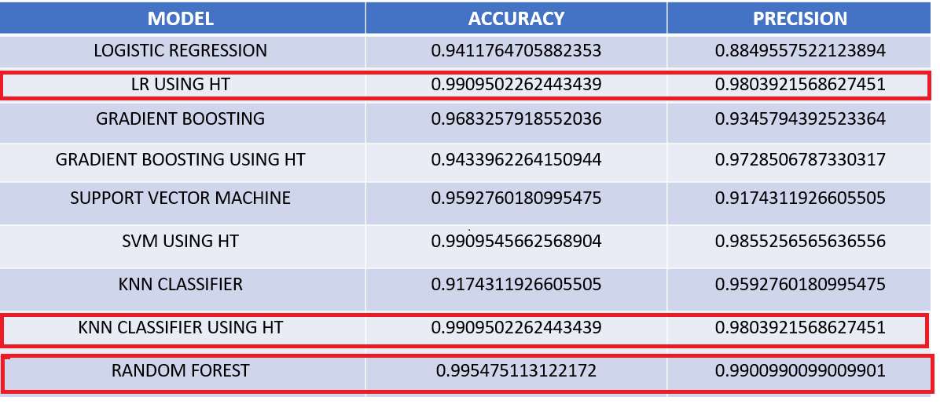
Summary
The hyperparameter tuned Logistic Regression, Support Vector Machine, and KNN models are all performing exceptionally well with almost perfect accuracy and precision-recall trade-off.
If required to move ahead, we would go ahead with Logistic Regression using HT.

